Slide 1
Using Classification Algorithms to Reduce Default Risk on Peer-to-Peer (P2P) Lending Platforms
CIS 4321
Singer Li, Brandon Nguyen, Abhishek Yenumula, and Dan Trinh
14 May 2021

Slide 2


Introduction
P2P Lending and its Risks
What is P2P lending?
Peer-to-peer (P2P) lending: An alternative to traditional bank loans. Individuals lend to other individuals.
Risk of default higher due to lack of established regulations.
Failing to curb risk can harm profitability.
What can be done?
This project determines if DM classification methods can assist in identifying defaults.
An effective classification model can help prevent risks.
This outcome would ensure a higher quality service which is more trustworthy to lenders.

Slide 3


Data Collection
The Bondora Dataset
Collecting Data
Data obtained from Bondora, an EU lending platform.
Dataset available on Bondora website.
Original dataset: Over 160,000 records with 112 attributes each!
Reducing Dimensionality
Keep only variables related to the application.
Remove IDs and dates.
Remove variables non-compliant with EU regulations:
General Data Protection Regulation Act (2016)
Council Directive 2004/113/EC
Review related literature to help identify important variables.
RESULT: 12 predictors over 16,931 observations (15% of original dataset)
Notes:
Explain how you collected data
Describe your dataset (i.e., variables)
Details of each variable used including the definition, source reliability, etc.
Then, anything pertaining to IDs and dates were removed. Next was to consider EU regulations such as the General Data Protection Regulation Act, which limits the sort of information Bondora can collect from customers, and Council Directive 2004/113/EC, which forbids discrimination in access to financial services based on gender. Finally, after reviewing related literature and performing exploratory analysis, we reduced the dataset to 12 predictors. We then sampled the dataset and retrieved 15% of it, resulting in 16,931 observations in total.

Slide 4


Variable Description
Demographic Information (6 Attributes)
Total (Monthly) Income
Debt-to-Income Ratio
Age
Country
Education
Employment Status
Loan App Information
(5 Attributes)
New Credit Customer?
Applied Amount
Interest
Loan Duration
Previous Early Repayments Count Before this Loan
Outcome Variable
Defaulted
Notes:
Explain how you collected data
Describe your dataset (i.e., variables)
Details of each variable used including the definition, source reliability, etc.

Slide 5
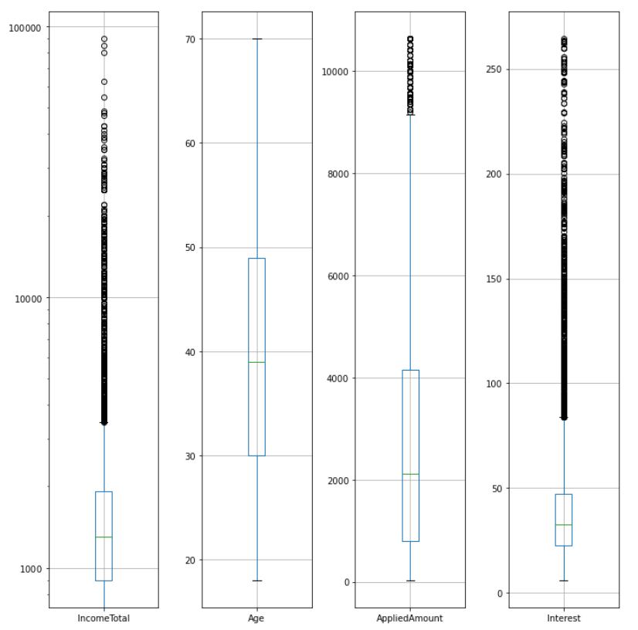
Descriptive Analysis
Numerical Variables
Total Income (shown with logarithmic scale): Heavily skewed!
We removed the top 50 incomes, reducing skew from 113 to 10.
Age: Even distribution; no skew.
Applied Amount: Light skew of 1.
Interest: Relatively light skew of 3.

Slide 6
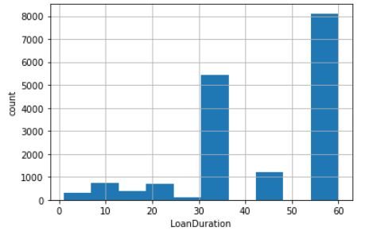
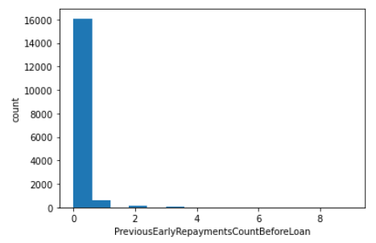
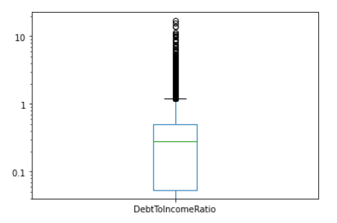
Descriptive Analysis
Numericals, cont’d.
Loan Duration
Loan durations range from 0-60 mo.
Previous Early Repayments
A small minority have a history of making early repayments.
Debt to Income Ratio
The majority of the dataset has a debt to income below 1.

Slide 7
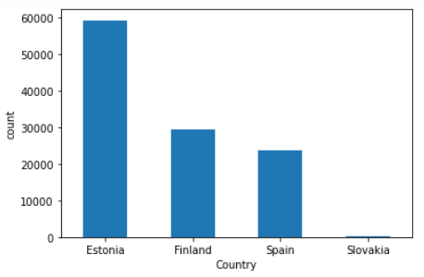
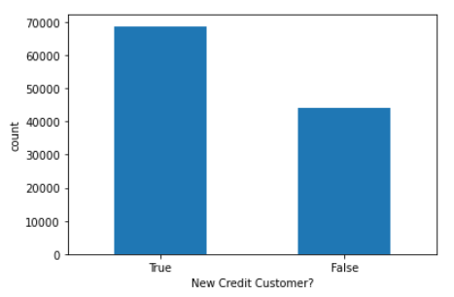
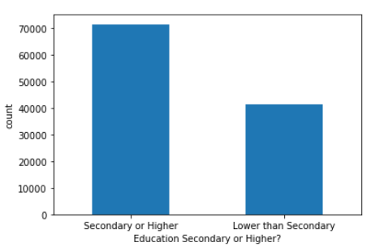
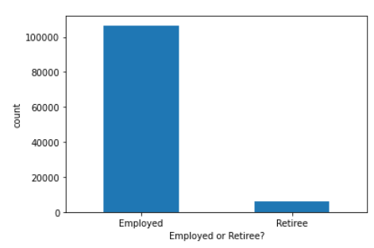
Descriptive Analysis
Categorical Variables
Country
Most borrowers are from Estonia (you must have an Estonian bank account to join Bondora)
New Credit Customer?
The majority of borrowers are borrowing for the first time.
Education
The majority of borrowers have graduated secondary or higher.
Employment
A small minority are retired.

Slide 8
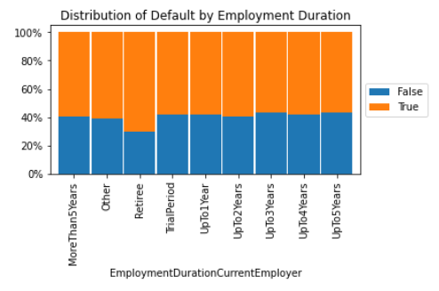
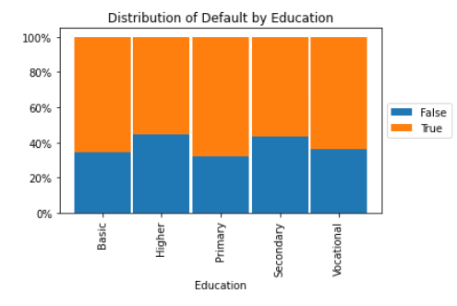
Descriptive Analysis
Combining Categorical Variables with Low Separation
The employment and education variables had many dimensions when converted to dummies.
Thus, we combined categories with low separation.
Hence EducationSecondaryOrHigher and EmployedOrRetiree.

Slide 9
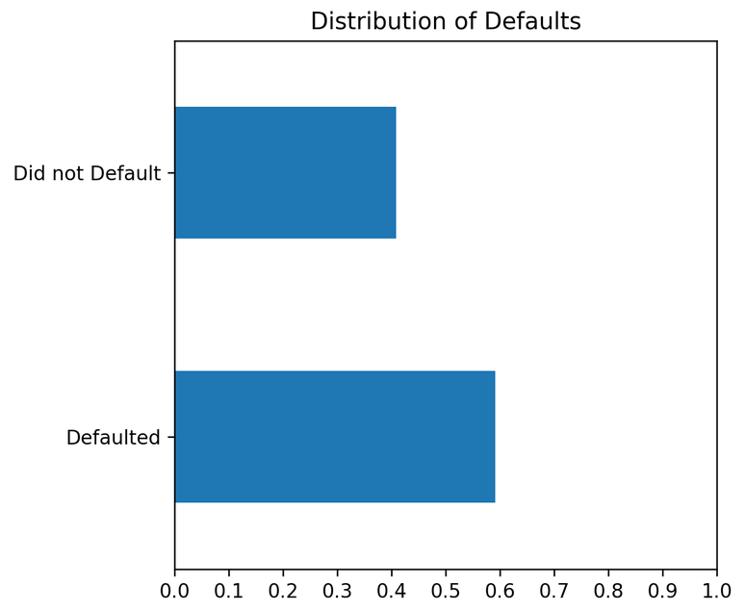
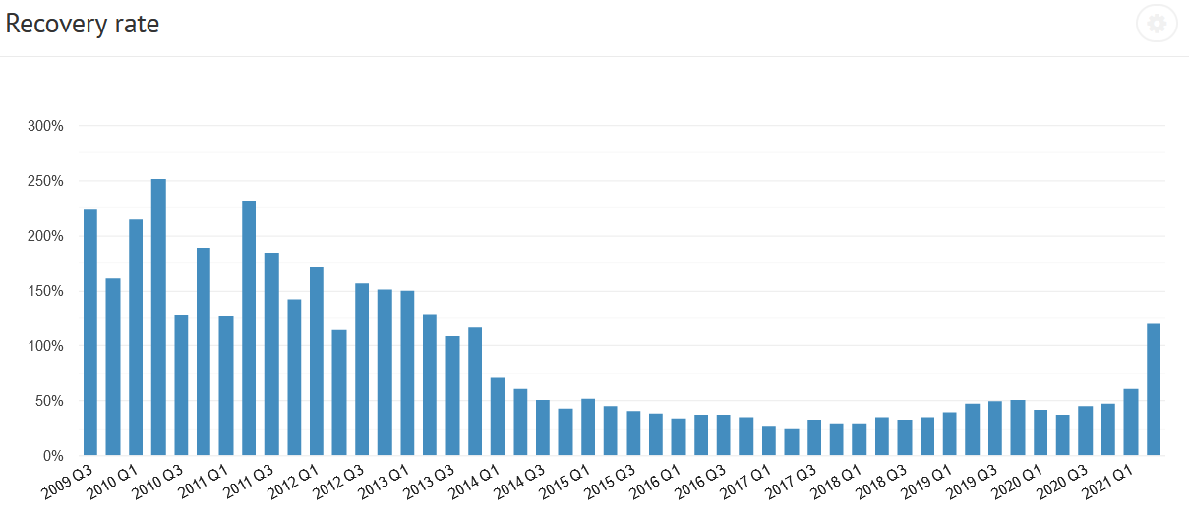
Descriptive Analysis
Distribution of Defaults
High default rate - 60% of all completed loan cases defaulted!
Note that this does not mean the loan is written off, Bondora simply initiates legal action.
Still a chance to recover investment.
Nonetheless, recovery rate (% of principal the lender is likely to receive after default) has been in a declining trend since 2013.
Recovery rate does not account for interest.
Overall a concern for potential investors.
Notes:
Following exploratory analysis, it was time to perform descriptive analysis of the predictors in the dataset.
The first step was to see how the % distribution of defaults.
When analyzing the distribution of Defaults to determine our Naive Rule, we saw that 60% of completed loans were considered defaulted!!!
Now this may sound high, but we found that this was because Bondora considers a loan defaulted when a borrower hasn’t paid in more than 60 days.
This doesn’t mean that it’s not written off, but Bondora just proceeds with legal action to attempt to recover the principal. Just the principal, not the interest the lender could have earnt.
Additionally, it doesn’t help that the recovery rate, the % of principal recovered on the loan, has been in steady decline in the past several years.
First was to see the distribution of defaults
Descriptive analysis
Show % of defaults.
§Descriptive Statistics
Use Singer’s boxplots and histograms through multiple slides to help describe demographic information and loan application information.
§Visualization
Demonstrate low separation between education and employment attributes when based on Default / No Default.
§These should guide your main analysis
Visualize default total too.

Slide 10
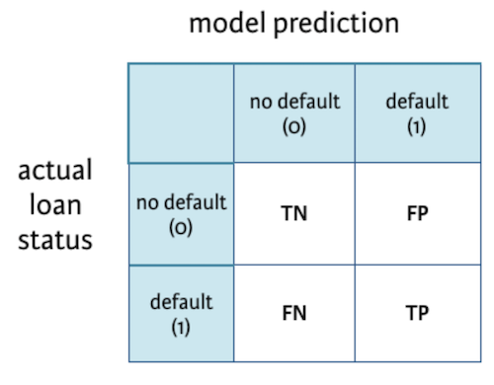
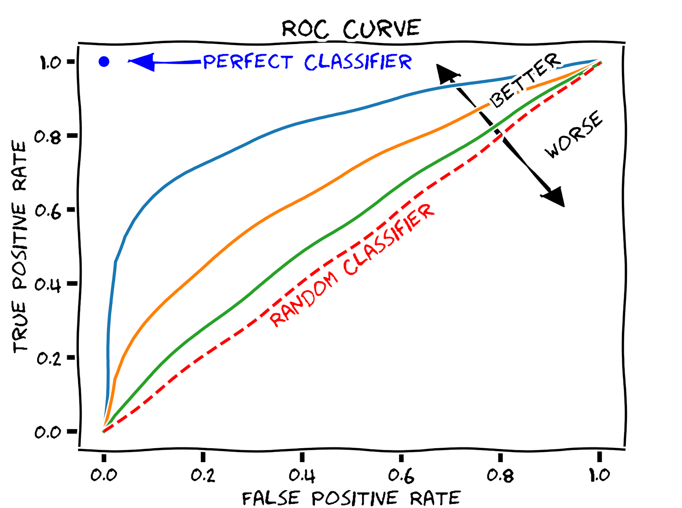
Data Analysis
Picking a Method of Analysis
Four models chosen based on related literature:
k-Nearest Neighbors
Naive Bayes Classifier
Classification Trees
Random Forest
SMOTE for balancing data when fitting model.
Parameter tuning to optimize model performance.
Analyzing Model Performance
Classification Matrix Metrics.
Accuracy
Precision
Sensitivity (% of defaults correctly classified)
Specificity (% of non-defaults correctly classified)
ROC Curve.
Useful visualization for comparing model performance.
Notes:
Explain your method of analysis
Chose our four models based on different studies done using Bondora dataset or similar topic.
Use of SMOTE for all models to balance data and improve overall scores.
non-default records had 7,104 records
defaults had 10,245 records.
Parameter tuning to optimize performance
Classification matrix
Accuracy, precision, sensitivity (% of class 1 - default correctly classified), and specificity(% of class 0 - non-default correctly classified)
ROC curve

Slide 11
Data Analysis, cont’d.
An optimal model will identify defaults effectively without significantly misclassifying non-defaults (false positives) and help make better business decisions.
The confusion matrix scores the models and helps us determine their predictive power.
Our results:
Naive Bayes model is biased towards non defaults vs. defaults.
Although it classifies people who would default effectively, too many false positives (low specificity).
The other three models performed similarly well and some had better scores in specific areas than other.
Notes:
Explain the results while being business-oriented
Choosing a model with better results can help with better identifying defaults vs. non defaults to improve the overall business.
Naive Bayes model is biased towards non defaults vs. defaults. It's important the default recall score isn’t too low because main priority should classifying people who would default.
Other three models performed well and some had better scores in specific areas than other.
Use of a better overall model can help make better decision in general.

Slide 12
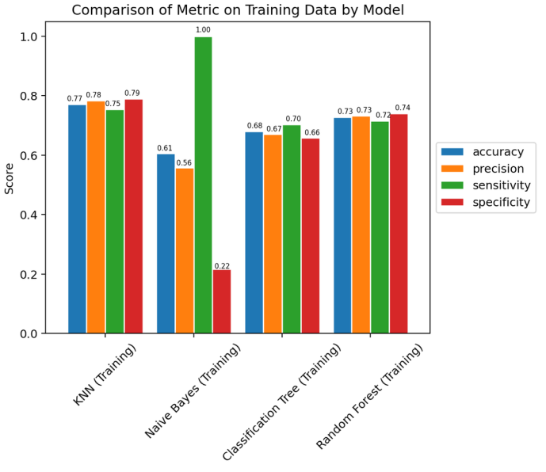
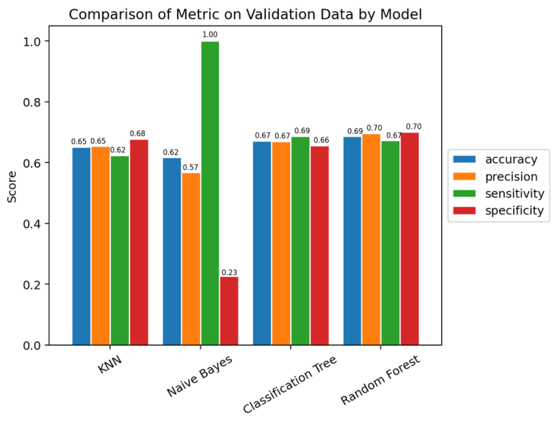
Summary of Findings
Train Data
Test Data

Slide 13
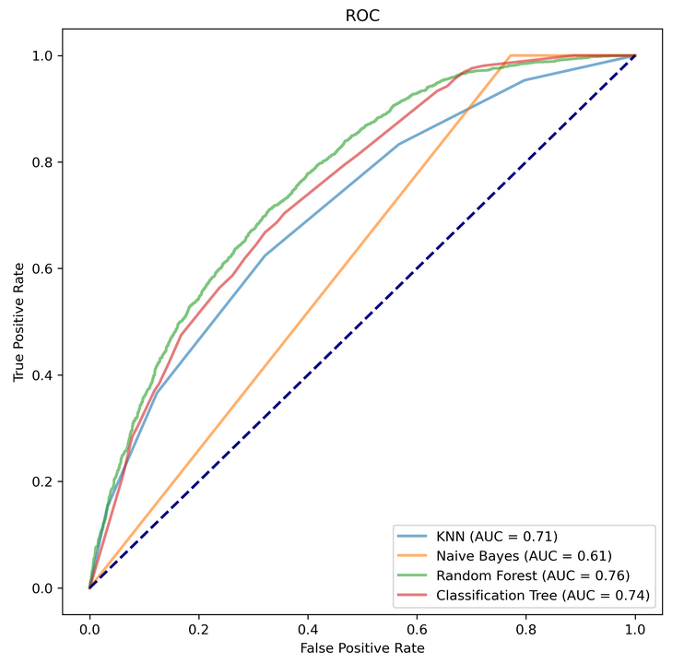
Summary of Findings, cont’d.
Out of the four models, Naive Bayes performed the worst.
Sensitivity:100%
Specificity: 22%(train) and 23%(test).
KNN, Classification Trees, and Random Forest models, their results were in the range around 60%-79% for each metric for both train and test data.
Random Forest was the overall best-performing model.
The ROC curve confirms Random Forest is the most effective (has greatest AUC value)
Notes:
Summarize your findings here.
Which model was the best…?
Out of the four models, Naive Bayes didn’t have the best results.
Sensitivity:100%
Specificity 22%(train) and 23%(test).
KNN, Classification Trees, and Random Forest models, their results were in the range around 60%-79% for both train and test data.
Random Forest was the overall better model.

Slide 14

Implications
Data mining algorithms are effective tools for managing default risk.
Given our model’s predictive power, Bondora can use this to effectively make decisions that reduce risk of default. This:
Reduces the need to initiate legal action to collect.
Improves service quality for potential lenders.
Reduce losses from defaults.
Notes:
Explain how your results help improve business performance.
Add more slides as needed
Remember, you only have 5 minutes for this presentation

Slide 15

Limitations
Indiscriminate of external factors like economic conditions.
The COVID-19 pandemic is not indicative of typical economic conditions.
Model only applies to four countries (Estonia, Spain, Finland, and Slovakia).
Default risk will need to be reassessed if Bondora expands to other nations.
Notes:
If your data/analysis suffers from serious limitations, this is the place to discuss it
GDPR restrictions on collection of personal data
Another limitation is if regulations require us to disclose the model, then usage of methods like random forests are unacceptable because of difficulty in interpretation.
Doesn’t take into account ongoing external factors such as economic conditions or the pandemic
Defaults can be recovered
Model only works on four countries; if Bondora ever decides to expand its offerings to other territories in the EU, the model will need to be rebuilt to acknowledge those countries and their peculiarities.

Slide 16

Future Steps
Account for time period (recession periods).
Model might be more accurate if data limited by time period.
Explore variable significance.
Some predictors are more impactful than others.
Methods like logistic regression can offer such insight.
Test individual models for each country.
Build a model for each country instead of one aggregate model.
Bondora can then leverage each country’s credit score system in calculating defaults.
Notes:
How can you improve the results?
Explore use of other classification methods like SVM or use neural networks.
Try reducing predictors on bins for Naive Bayes
Using boosters and ensembles for our models.
Read more research papers to get more ideas on preprocessing and different models used.
What are your suggestions for future projects?
Different datasets according to time period, particularly recession conditions and non-recession conditions. (2009 - 2013) ← Great Recession Period (2014 - 2020) ← Economic Growth Period

